Slide 1
26-2 ELECTRONIC MAIL
One of the most popular Internet services is electronic mail (e-mail). The designers of the Internet probably never imagined the popularity of this application program. Its architecture consists of several components that we discuss in this chapter.
Topics discussed in this section:
Architecture
User Agent
Message Transfer Agent: SMTP
Message Access Agent: POP and IMAP
26.<number>

Slide 2

Figure 26.6 First scenario in electronic mail
26.<number>

Slide 3

Note
When the sender and the receiver of an e-mail are on the same system,
we need only two user agents.
26.<number>

Slide 4

Figure 26.7 Second scenario in electronic mail
26.<number>

Slide 5
Note
When the sender and the receiver of an e-mail are on different systems, we
need two UAs and a pair of
MTAs (client and server).
26.<number>

Slide 6

Figure 26.8 Third scenario in electronic mail
26.<number>

Slide 7
Note
When the sender is connected to the mail server via a LAN or a WAN,
we need two UAs and two pairs
of MTAs (client and server).
26.<number>

Slide 8

Figure 26.9 Fourth scenario in electronic mail
26.<number>

Slide 9

Figure 26.10 Push versus pull in electronic email
26.<number>

Slide 10
Note
When both sender and receiver are connected to the mail server via
a LAN or a WAN, we need two
UAs, two pairs of MTAs
and a pair of MAAs.
This is the most common situation today.
26.<number>

Slide 11
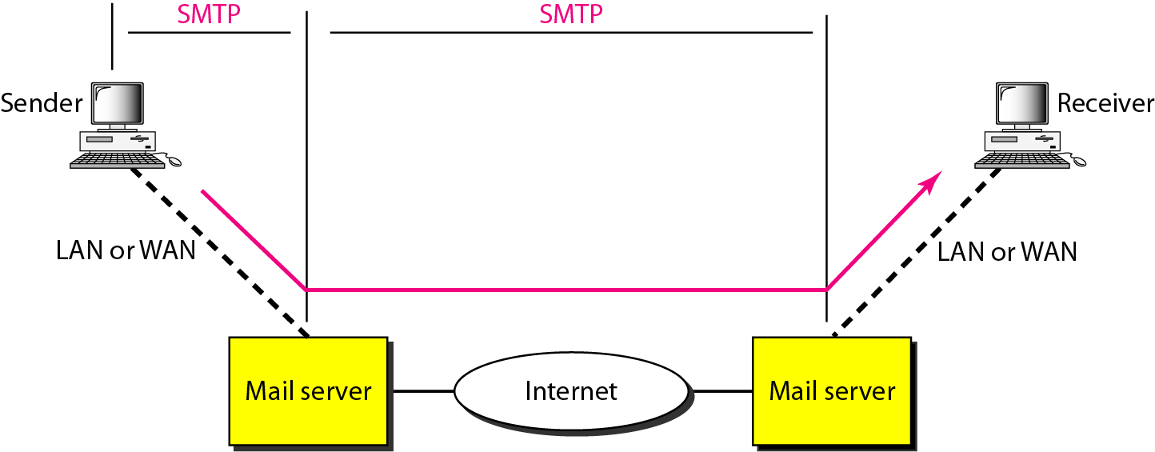
Figure 26.16 SMTP range
26.<number>

Slide 12

Figure 26.17 Commands and responses
26.<number>

Slide 13

Figure 26.18 Command format
26.<number>

Slide 14
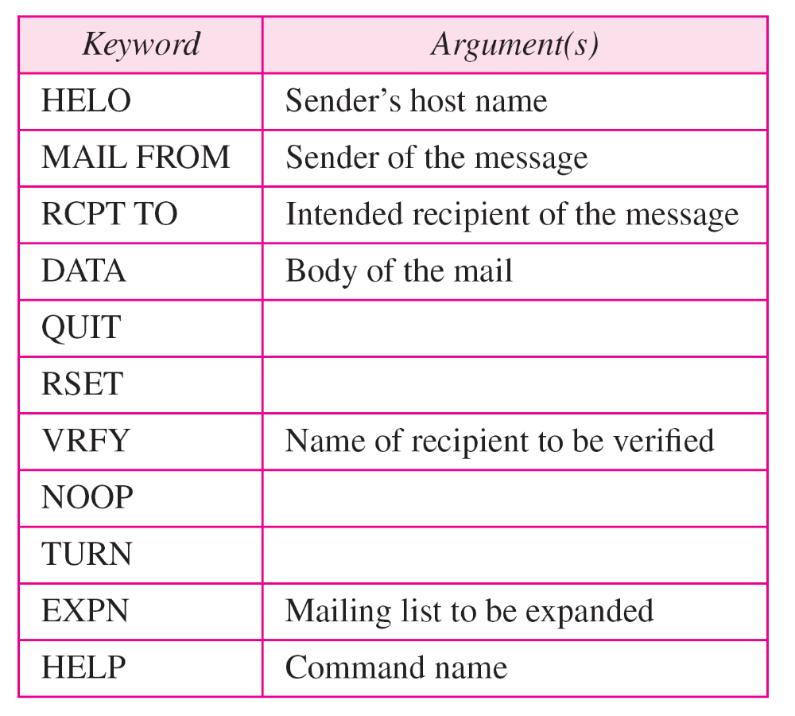
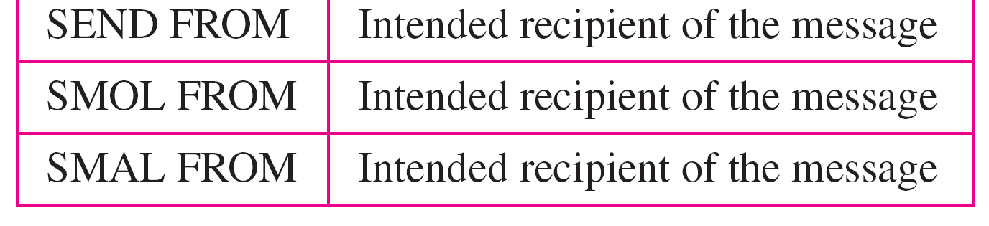
Table 26.7 Commands
26.<number>

Slide 15
Table 26.8 Responses
26.<number>

Slide 16
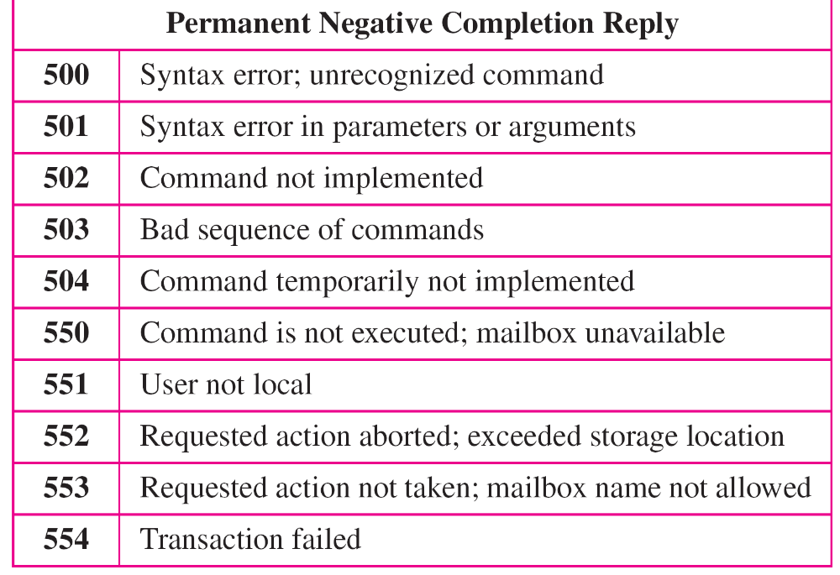
Table 26.8 Responses (continued)
26.<number>

Slide 17
Example 26.3
Let us see how we can directly use SMTP to send an
e-mail and simulate the commands and responses we described in this section. We use TELNET to log into port 25 (the well-known port for SMTP). We then use the commands directly to send an e-mail. In this example, forouzanb@adelphia.net is sending an e-mail to himself. The first few lines show TELNET trying to connect to the Adelphia mail server. After connection, we can type the SMTP commands and then receive the responses, as shown on the next slide. Note that we have added, for clarification, some comment lines, designated by the “=” signs. These lines are not part of the e-mail procedure.
26.<number>

Slide 18
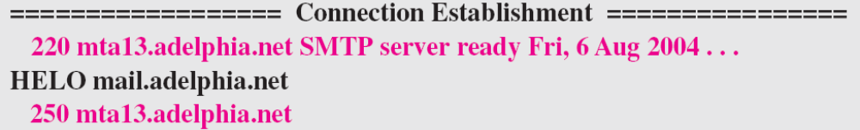
Example 26.3 (continued)
$ telnet mail.adelphia.net 25
Trying 68.168.78.100 . . .
Connected to mail.adelphia.net (68.168.78.100).
26.<number>

Slide 19
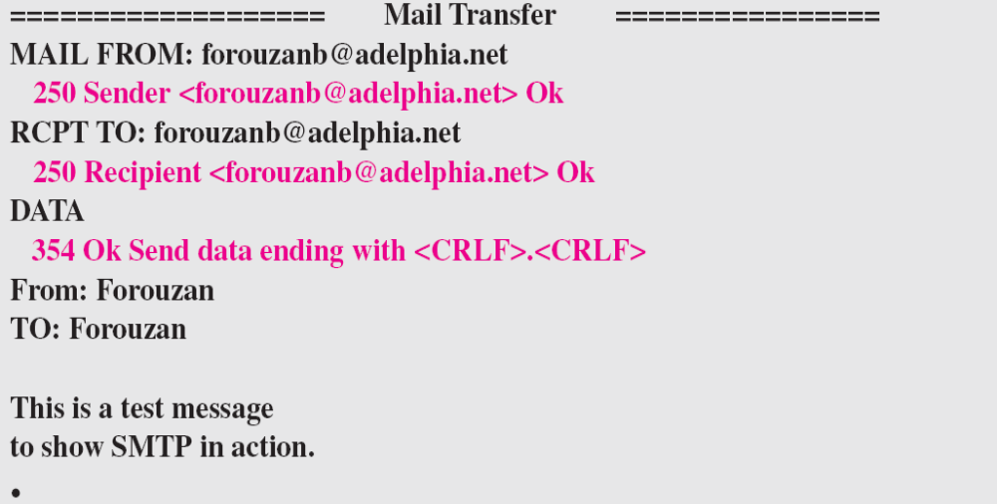
Example 26.3 (continued)
26.<number>

Slide 20
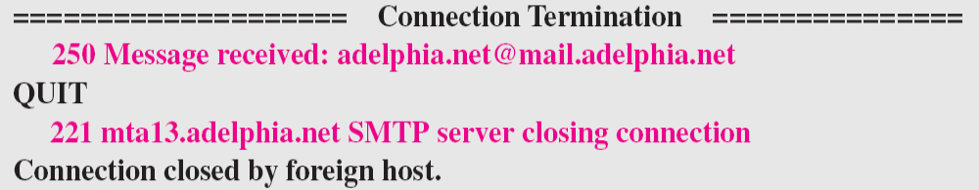
Example 26.3 (continued)
26.<number>

Slide 21
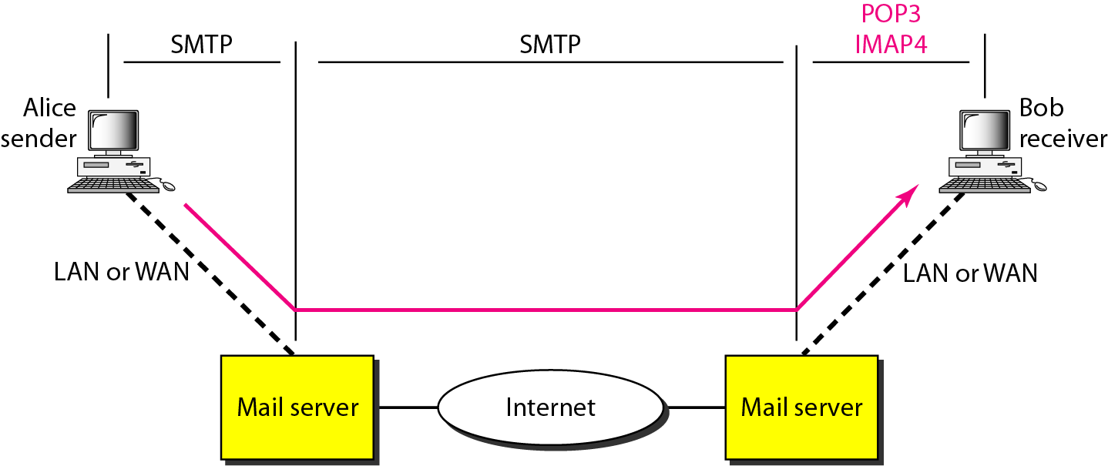
Figure 26.19 POP3 and IMAP4
26.<number>

Slide 22
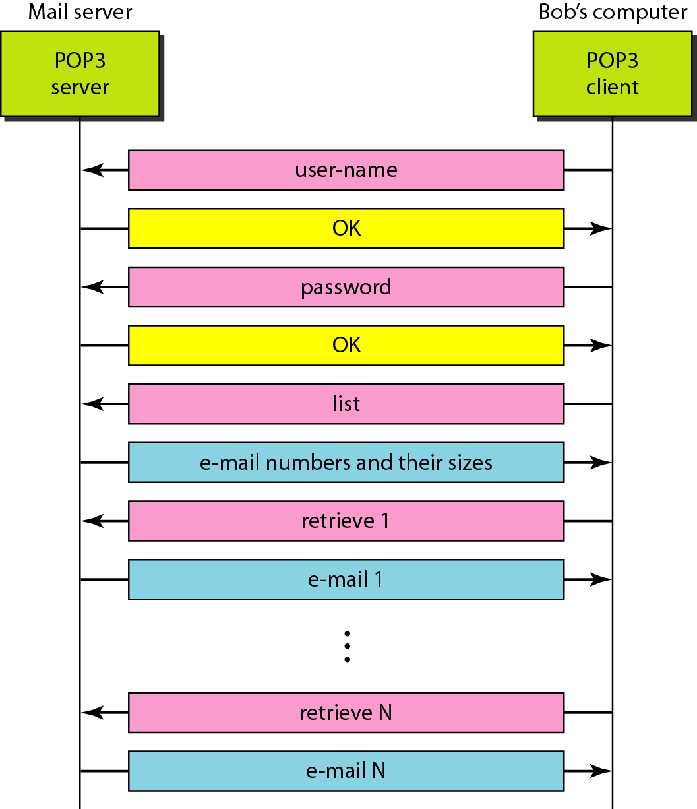
Figure 26.20 The exchange of commands and responses in POP3
26.<number>

Slide 23
26-3 FILE TRANSFER
Transferring files from one computer to another is one of the most common tasks expected from a networking or internetworking environment. As a matter of fact, the greatest volume of data exchange in the Internet today is due to file transfer.
Topics discussed in this section:
File Transfer Protocol (FTP)
Anonymous FTP
26.<number>

Slide 24
Note
FTP uses the services of TCP. It needs two TCP connections.
The well-known port 21 is used for the control connection and the well-known port 20 for the data connection.
26.<number>

Slide 25
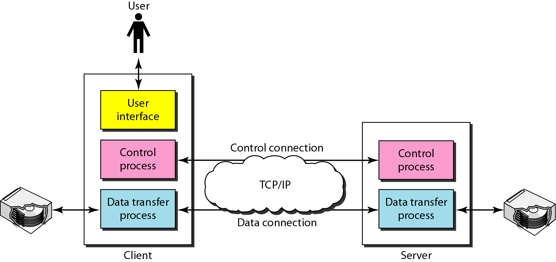
Figure 26.21 FTP
26.<number>

Slide 26
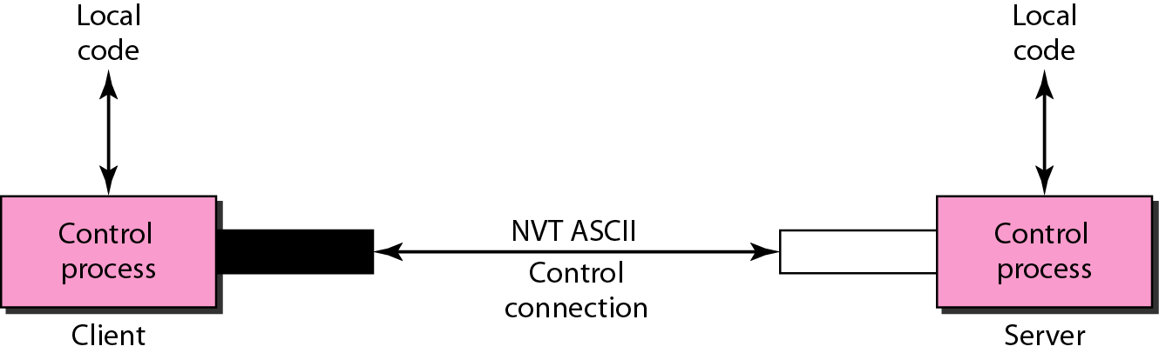
Figure 26.22 Using the control connection
26.<number>

Slide 27
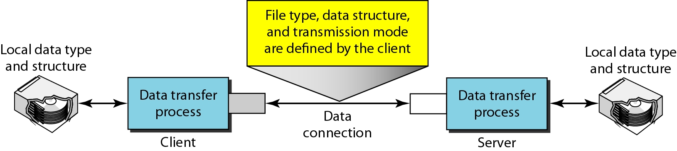
Figure 26.23 Using the data connection
26.<number>

Slide 28
Example 26.4
The following shows an actual FTP session for retrieving a list of items in a directory. The colored lines show the responses from the server control connection; the black lines show the commands sent by the client. The lines in white with a black background show data transfer.
1. After the control connection is created, the FTP server
sends the 220 response.
2. The client sends its name.
3. The server responds with 331.
26.<number>

Slide 29
Example 26.4 (continued)
4. The client sends the password (not shown).
5. The server responds with 230 (user log-in is OK).
6. The client sends the list command (ls reports) to find
the list of files on the directory named report.
7. Now the server responds with 150 and opens the data
connection.
8. The server then sends the list of the files or directories
on the data connection.
9. The client sends a QUIT command.
10. The server responds with 221.
26.<number>

Slide 30
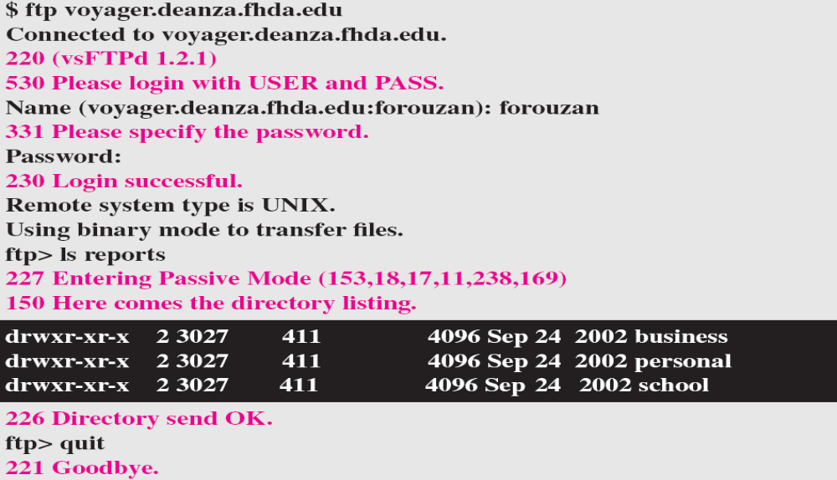
Example 26.4 (continued)
26.<number>

Slide 31
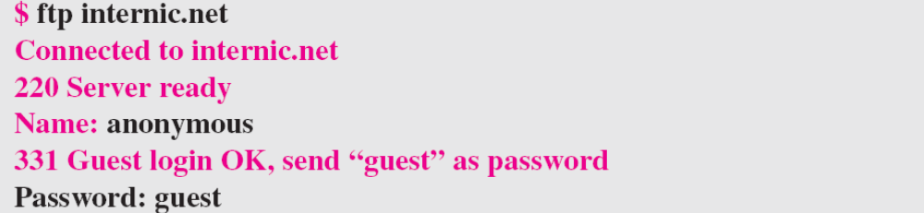
Example 26.5
We show an example of anonymous FTP. We assume that some public data are available at internic.net.
We show an example of anonymous FTP. We assume that some public data are available at internic.net.
continued on next slide
26.<number>

Slide 32
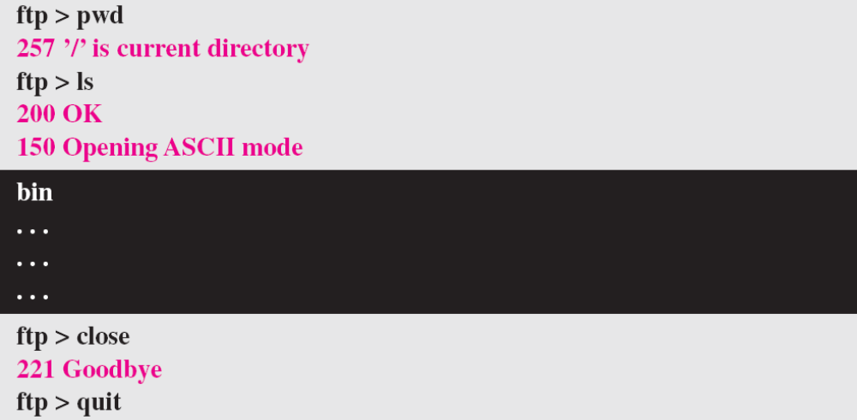
Example 26.5 (continued)
26.<number>

